Slide 1
Maths
Unit 6 – Fractions and Percentages.
WALT:
6Nf.02: Understand that a fraction can be represented as a division of the numerator by the denominator.
6Nf.02: Understand that proper and improper fractions can act as operators.
6Nf.07: Recognise percentages of shapes and whole numbers.

Slide 2
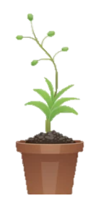
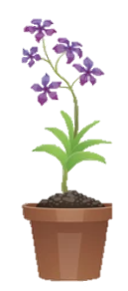
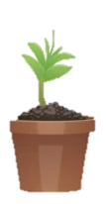
WALT: Understand that a fraction can be represented as a division of the numerator by the denominator.
Understand that proper and improper fractions can act as operators.
Recognise percentages of shapes and whole numbers.
With support, I can answer questions.
Independently, I can answers questions.
I can complete the “think like a mathematician” exercises.

Slide 3
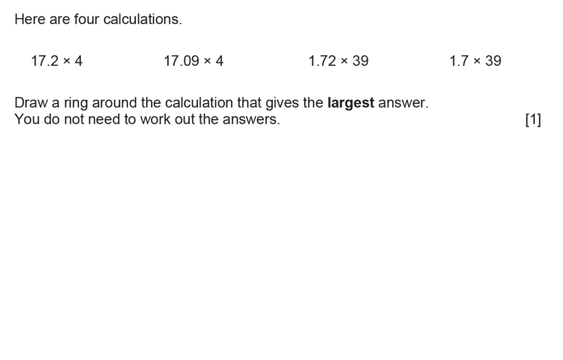
Retrieval Practice
WALT: Understand that a fraction can be represented as a division of the numerator by the denominator.
Understand that proper and improper fractions can act as operators.
Recognise percentages of shapes and whole numbers.
17.2 X 4

Slide 4
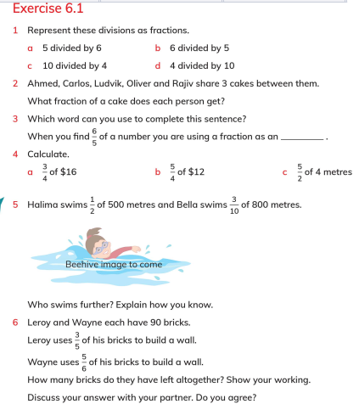
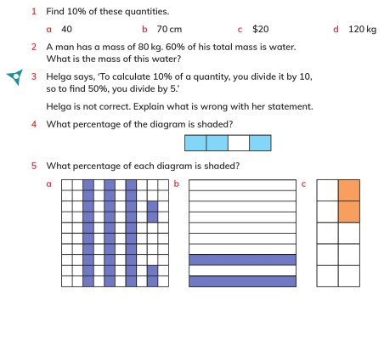
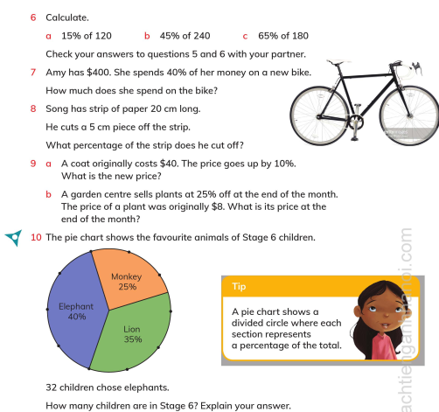
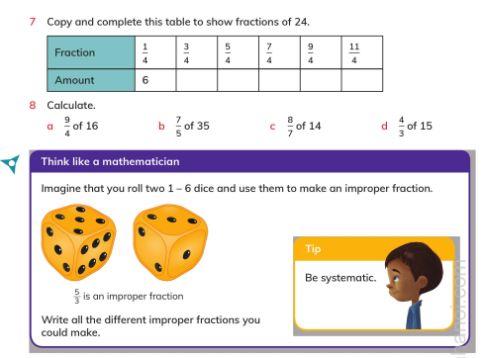
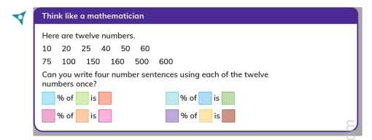
WALT: Understand that a fraction can be represented as a division of the numerator by the denominator.
Understand that proper and improper fractions can act as operators.
Recognise percentages of shapes and whole numbers.
Page 86 - 91

Slide 5
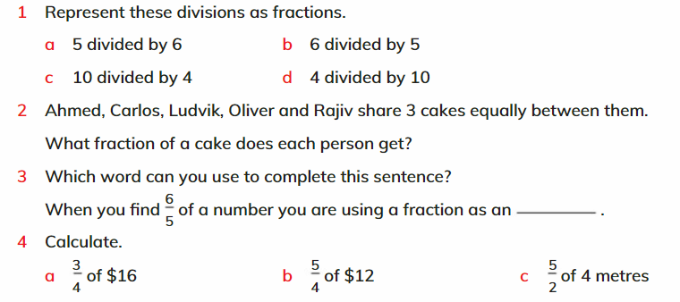





WALT: Understand that a fraction can be represented as a division of the numerator by the denominator.
Understand that proper and improper fractions can act as operators.
Recognise percentages of shapes and whole numbers.
Page 86 - 91
$$\frac{5}{6}$$
$$\frac{6}{5}$$
$$\frac{10}{4}$$
$$\frac{4}{10}$$
$$\frac{3}{5}$$
operator
10 metres
$12
$15

Slide 6
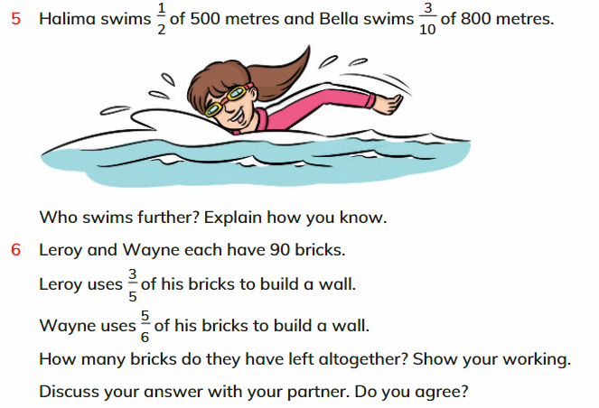
WALT: Understand that a fraction can be represented as a division of the numerator by the denominator.
Understand that proper and improper fractions can act as operators.
Recognise percentages of shapes and whole numbers.
Halima swims further. One half of 500m is 250 metres. Three tenths of 800 metres is 240 metres.
Leroy has 90 bricks.
Has 2/5 remaining = 36
Wayne has 90 bricks.
Has 1/6 remaining = 15
36 + 15 = 51

Slide 7
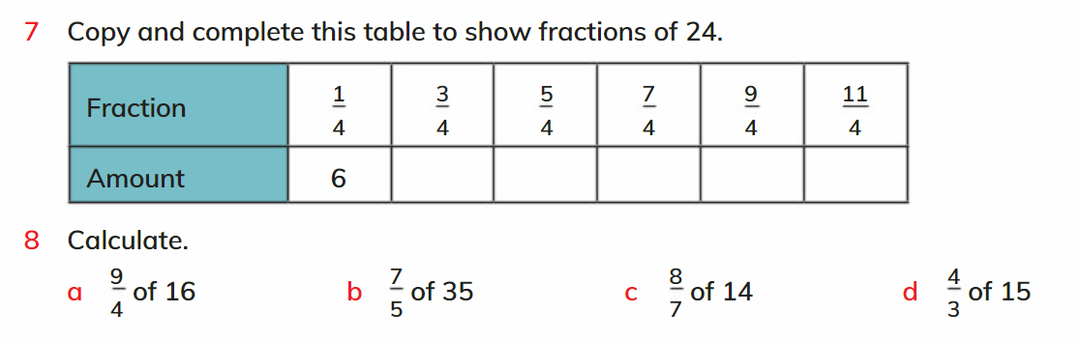
WALT: Understand that a fraction can be represented as a division of the numerator by the denominator.
Understand that proper and improper fractions can act as operators.
Recognise percentages of shapes and whole numbers.
18
30
42
54
66
36
49
16
20

Slide 8
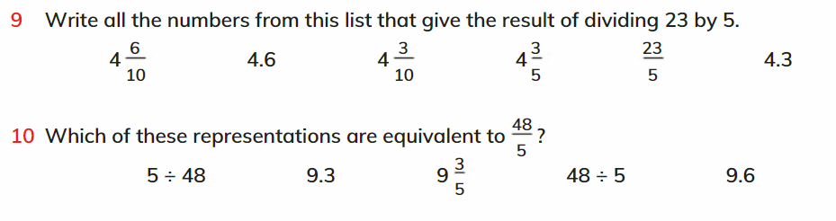
WALT: Understand that a fraction can be represented as a division of the numerator by the denominator.
Understand that proper and improper fractions can act as operators.
Recognise percentages of shapes and whole numbers.

Slide 9
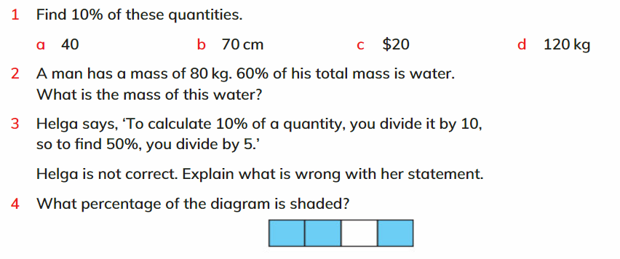
WALT: Understand that a fraction can be represented as a division of the numerator by the denominator.
Understand that proper and improper fractions can act as operators.
Recognise percentages of shapes and whole numbers.
4
7cm
$2
12 kg
48 kg
To find 50% you divide by 2.
75%

Slide 10
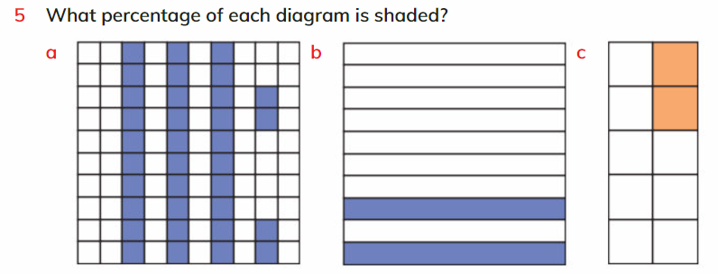
WALT: Understand that a fraction can be represented as a division of the numerator by the denominator.
Understand that proper and improper fractions can act as operators.
Recognise percentages of shapes and whole numbers.
34%
20%
20%

Slide 11
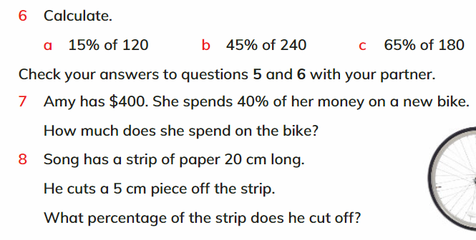
WALT: Understand that a fraction can be represented as a division of the numerator by the denominator.
Understand that proper and improper fractions can act as operators.
Recognise percentages of shapes and whole numbers.
18
108
117
$160
25%

Slide 12
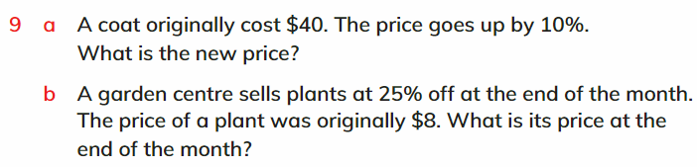
WALT: Understand that a fraction can be represented as a division of the numerator by the denominator.
Understand that proper and improper fractions can act as operators.
Recognise percentages of shapes and whole numbers.
$44
$6

Slide 13
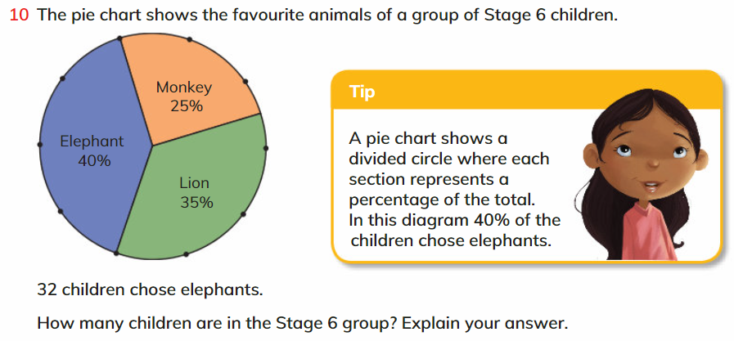
WALT: Understand that a fraction can be represented as a division of the numerator by the denominator.
Understand that proper and improper fractions can act as operators.
Recognise percentages of shapes and whole numbers.
80 children. We know that 40% is 32 children. If we divide 32 by 4 we get 10% which is 8 children. If 10% is 8 children then 100% must be 80 children.

Slide 14
WALT: Understand that a fraction can be represented as a division of the numerator by the denominator.
Understand that proper and improper fractions can act as operators.
Recognise percentages of shapes and whole numbers.
With support, I can answer questions.
Independently, I can answers questions.
I can complete the “think like a mathematician” exercises.

